Slide 1

The student data that keeps on giving
Matt C., Kat G., Tyler B.

Slide 2
Problem
Solution
Teachers face a problem that they start the school year with limited information about the knowledge level of their students. In the remainder of the school year their students’ progress is tracked on an ad-hoc basis with quizzes.
Our application serves to provide a method for teachers to give formative assessments to their students to understand the materials that they already know and what they need to teach.

Slide 3
Overview of talk
Design changes
Prototype implementation

Slide 4
Tasks
Easy : The teacher manages all quizzes given to students
Medium : The teacher creates custom quizzes for students
Hard : The teacher checks the student’s progress

Slide 5
Heuristic Evaluation Results
Categories | # Violations
Level 0 | 7
Level 1 | 14
Level 2 | 7
Level 3 | 4
Level 4 | 0
Total | 32
Level 3 violations:
Tasks not delineated clearly enough from the beginning
Quiz results page hard to decipher
Lack of error prevention
Confusing shapes and colors used in data visualization

Slide 6
Overview of Revised Design

Slide 7
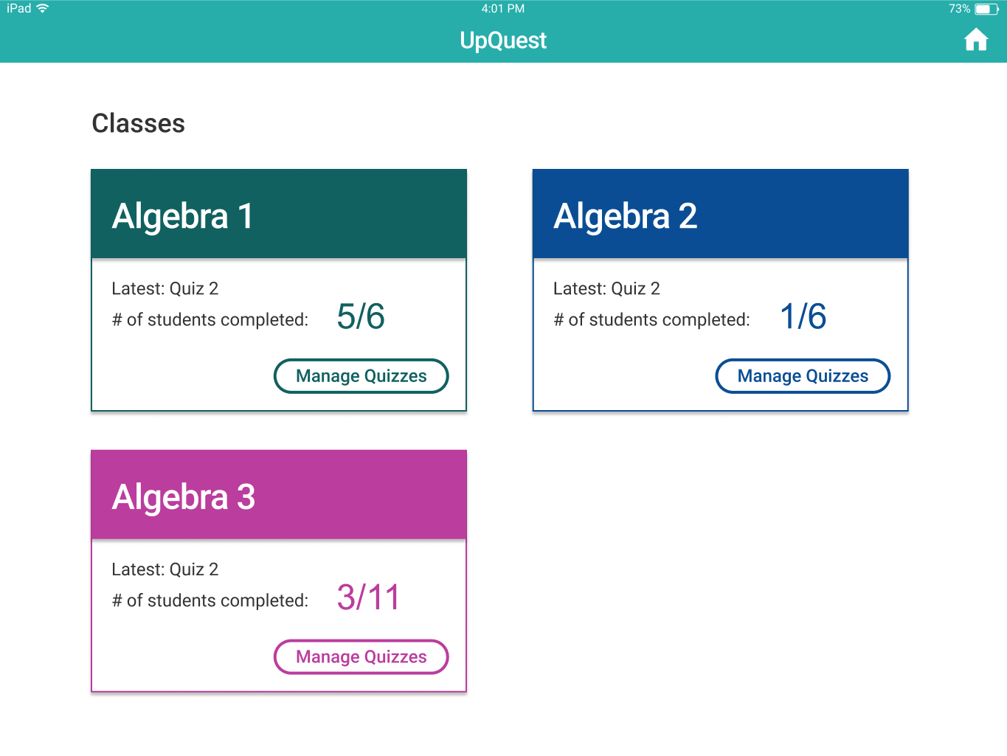
Violation:
Tasks not delineated clearly enough from the beginning
[H2-1: Visibility of System Status]

Slide 8
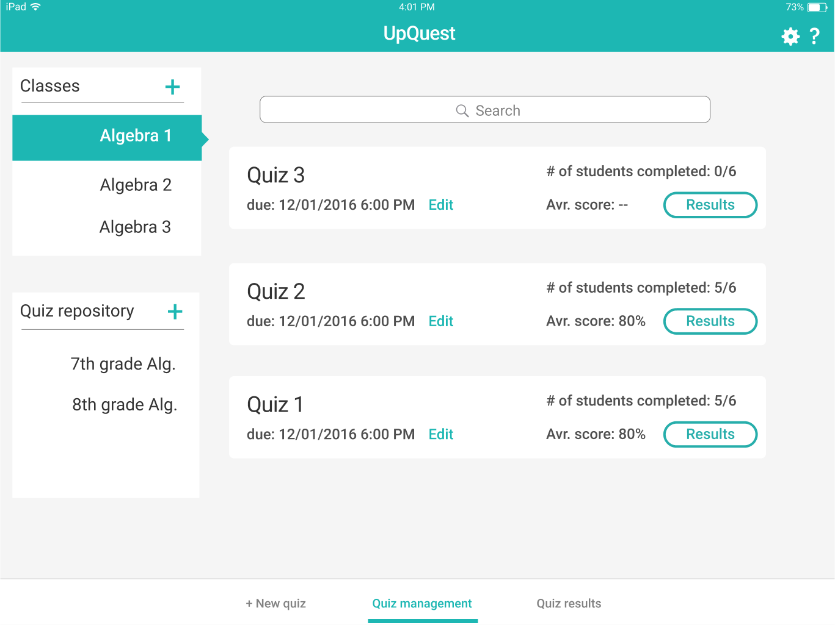
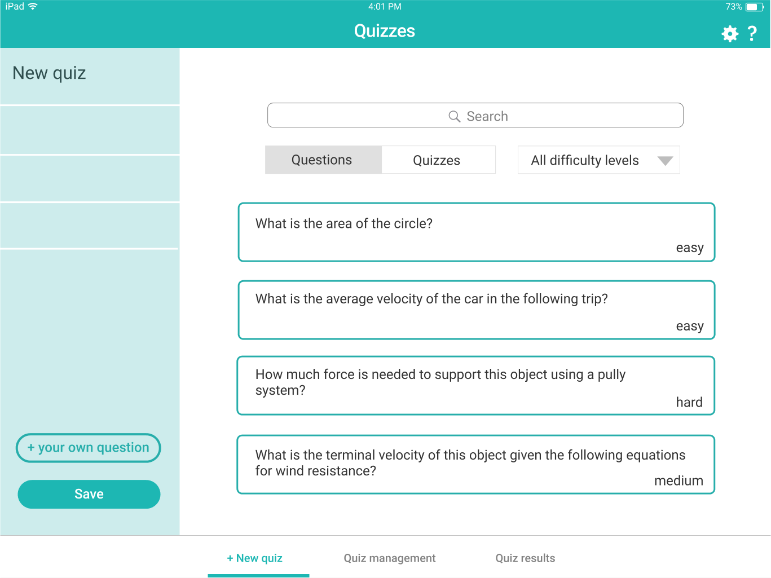
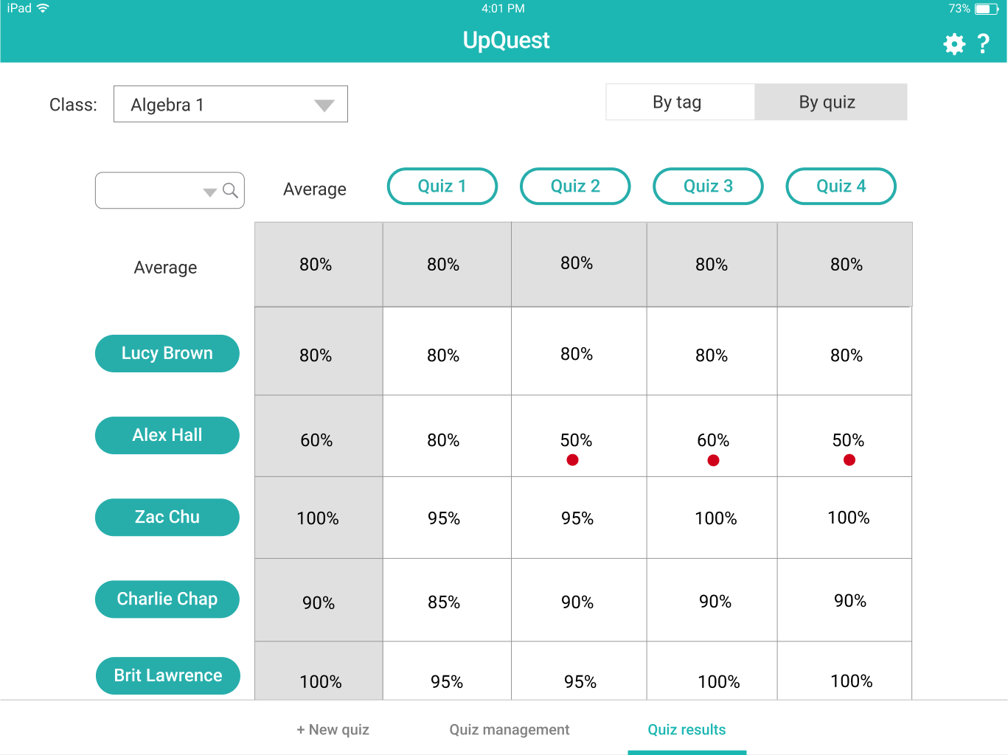
Revision: Navigation bar

Slide 9
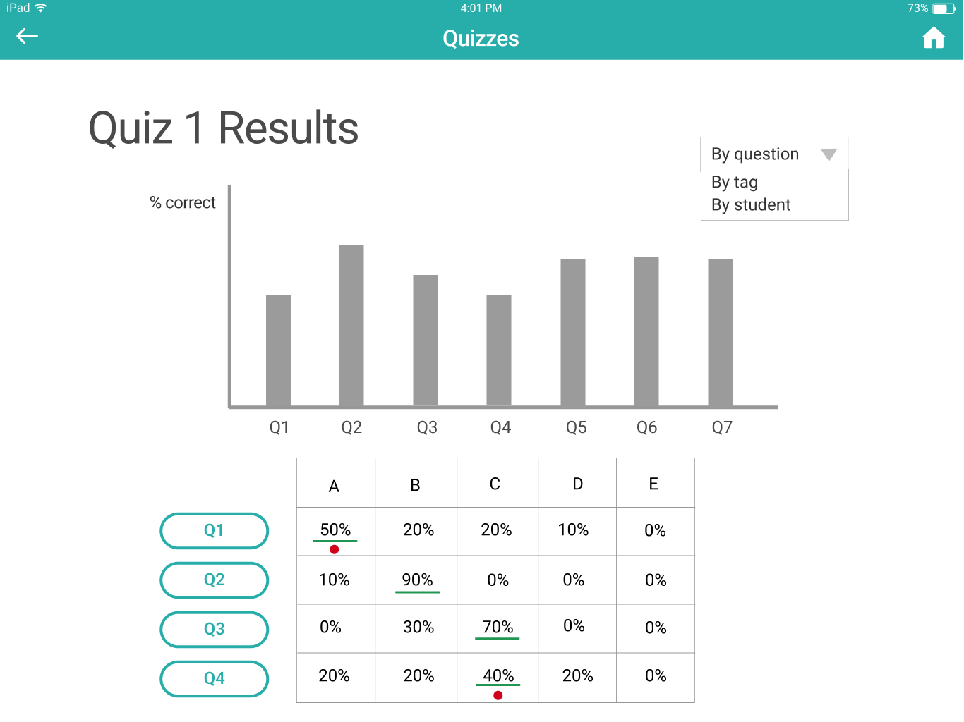
Violation:
Quiz results page hard to decipher
[H2-2: Match between system and the real world]
[H2-8: Aesthetic and Minimalist Design]

Slide 10
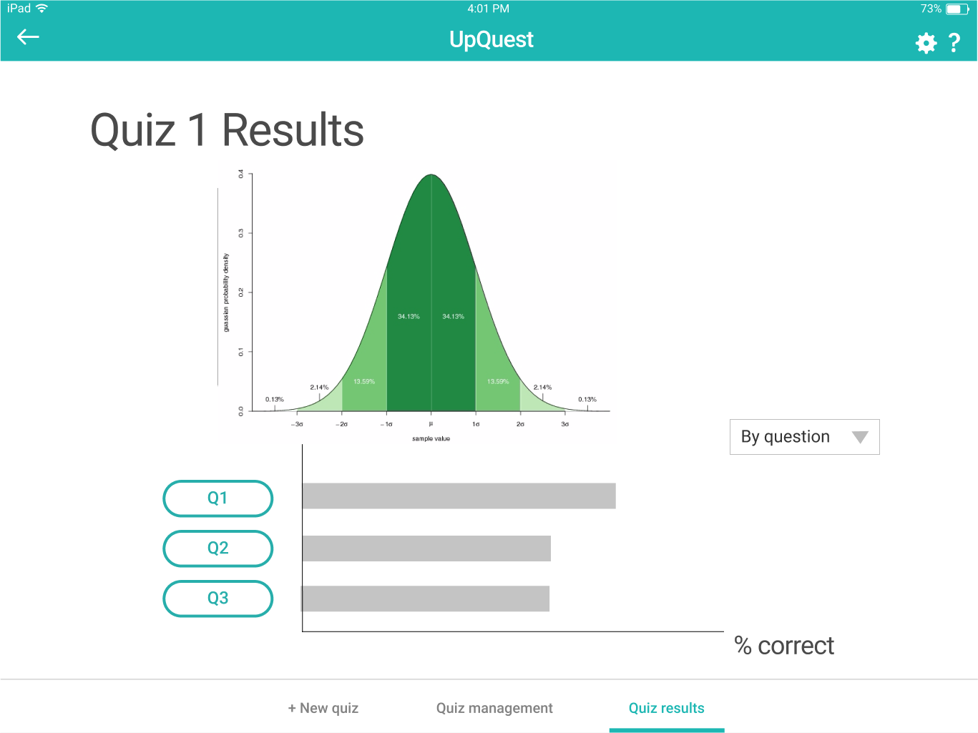
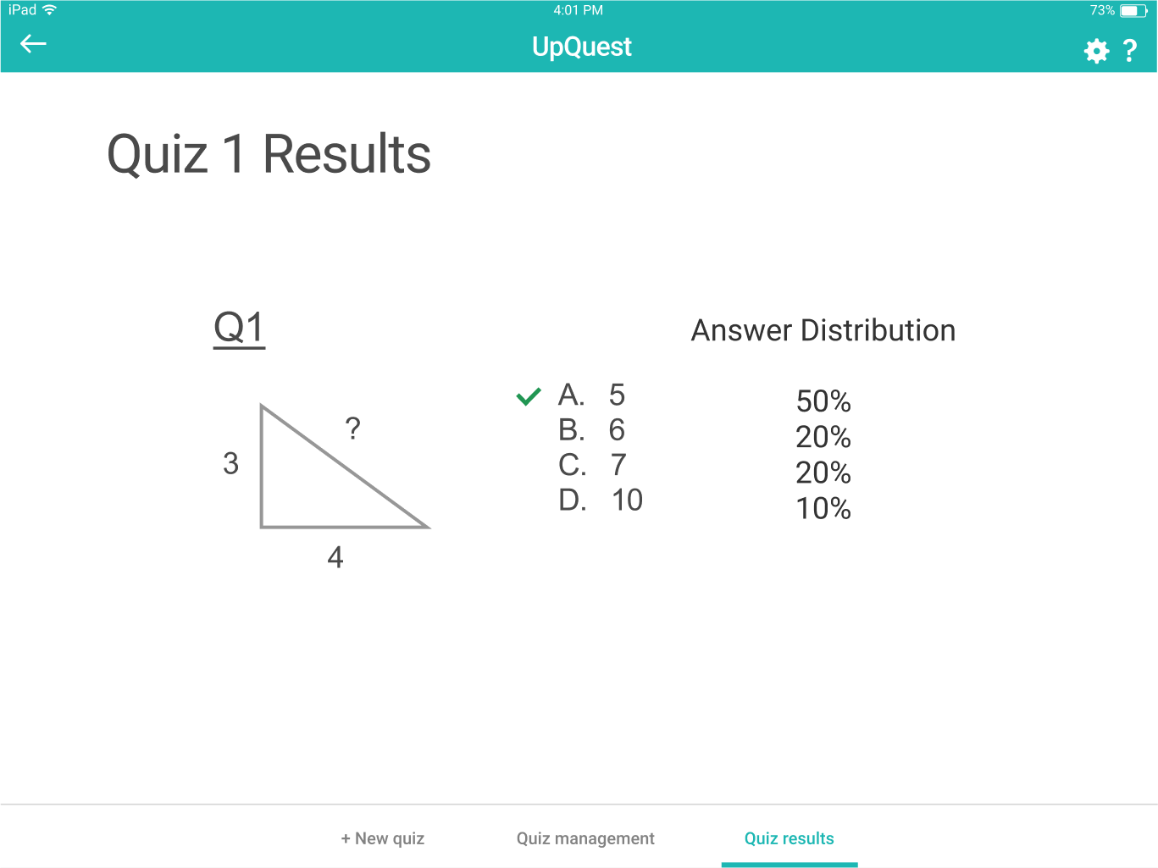
Revision: probability density function; answer distribution showed on a new page

Slide 11
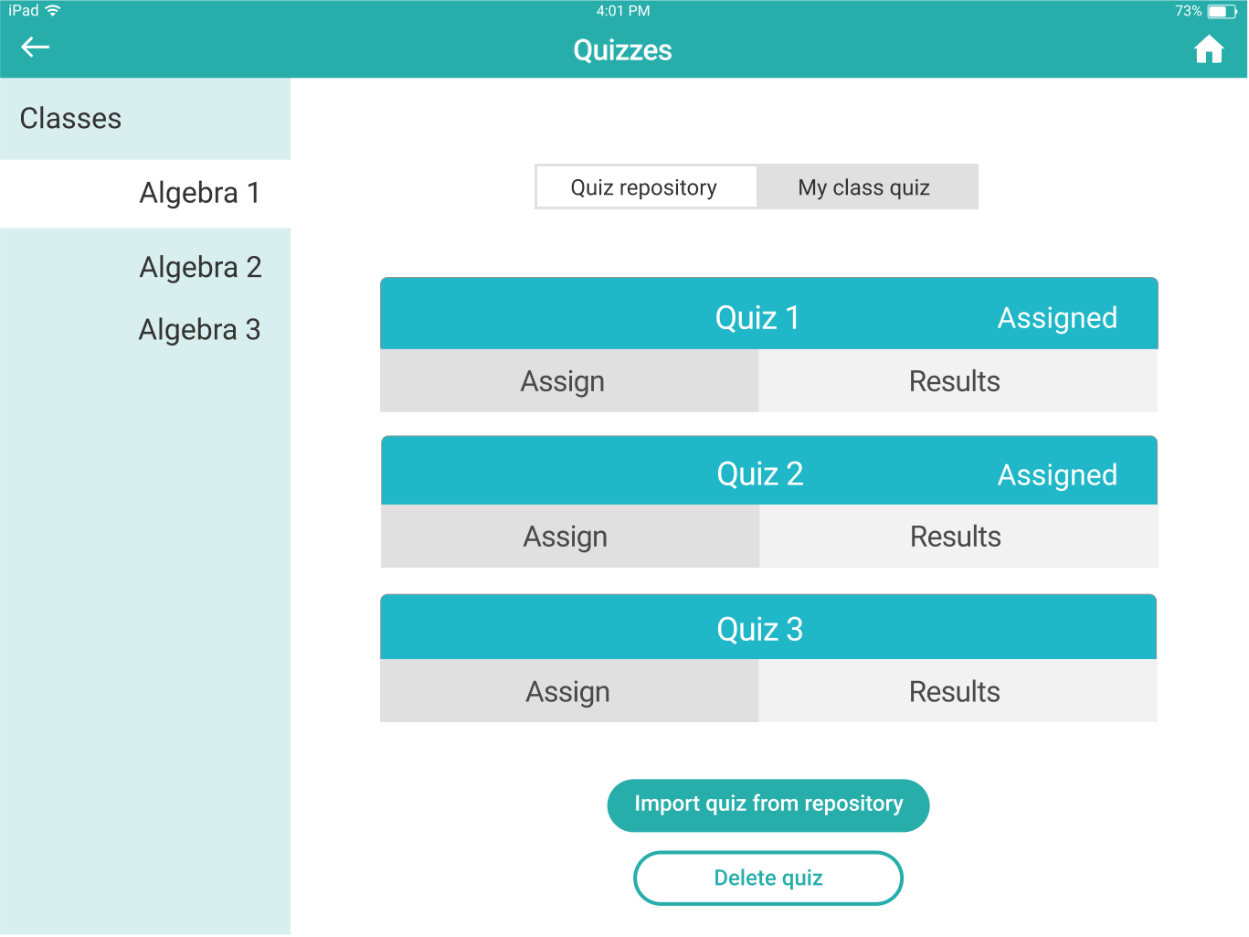
Violation:
No way to edit assigned quiz
[H2-5: Error Prevention]

Slide 12
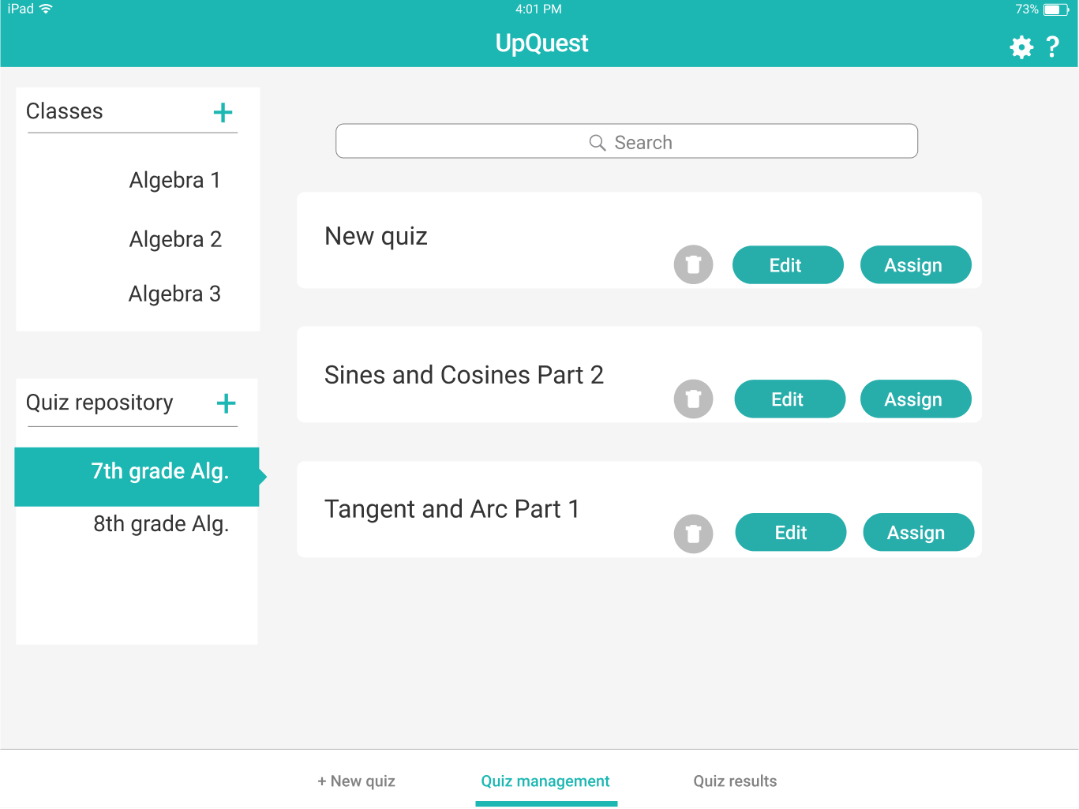
Revision: Edit button for assigned quizzes; assign button moved to repository

Slide 13
Prototype Implementation Status

Slide 14
Product Development Timeline
IPad App Development (Remaining Tasks)
Set Widgets for Task 2 and 3
Connect Widgets to Controller
Match Aesthetics to Design Spec
Manually Test UI for issues
IPad App Development (Single Task)
Built Backend Data Model
Unit tested backend
Set up Storyboard Widgets
Link Widgets to Controller logic
Week 1
Now
Finalize Design Specification
Incorporated Heuristic Evaluation Feedback in Figma Sketches
Midway Presentation!
Week 2
Week 3

Slide 15
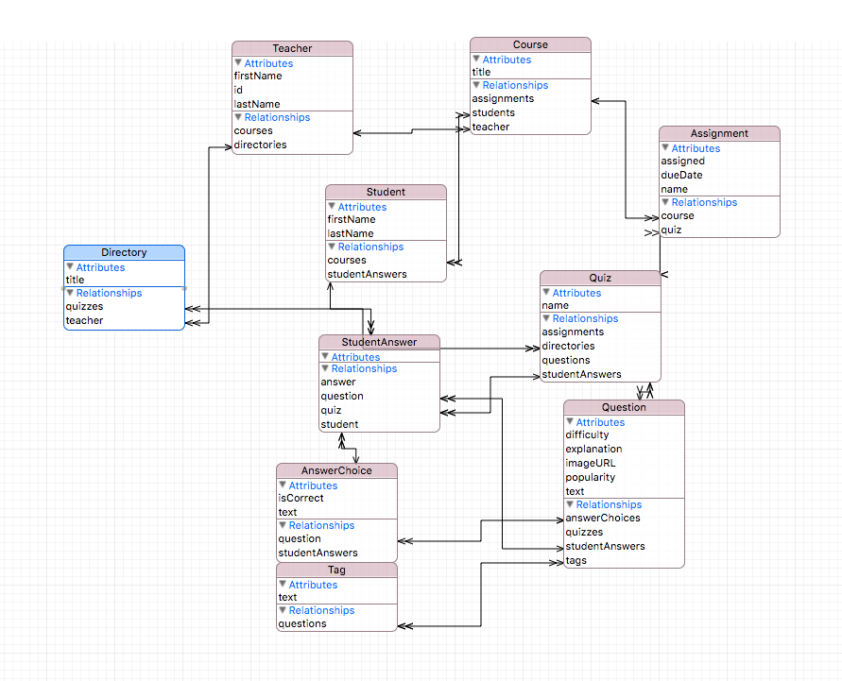
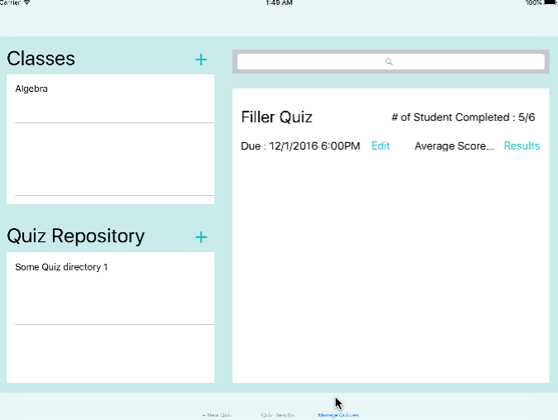
Backend Data Model
Manage Assignments

Slide 16
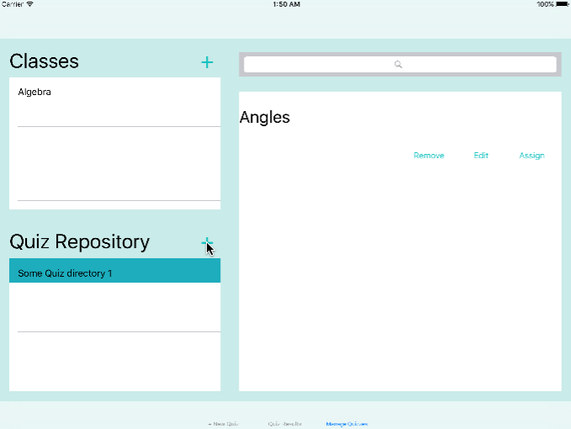
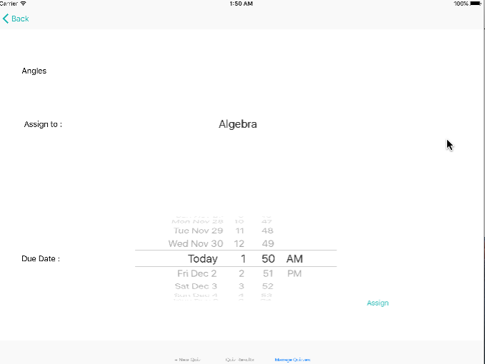
Manage Quizzes
Assign Quizzes

Slide 17
Features Not Implemented
Hard Coded Data
Context Specific Help Menu
Settings Page from navigation bar
Creation of new classes
All data from backend data model
Current calculation of average scores by quiz
Query results from search bar

Slide 18
Prototype Demo

Slide 19
Summary
Completed functionality for task of assigning quizzes to classes
Moving on to complete remaining two tasks in the next week

